Slide 1
Lesson 11 ANOVA test Concepts E214 – Statistical Methods for Engineering

Slide 2
E214 – Statistical Methods for Engineering
Inferential Statistics
Hypothesis Testing
Parameter Estimation
Organize & summarize data collected
Probability and Distributions
Venn Diagram
Discrete Random Variables and Probability Distributions
Probability Distributions
Descriptive Statistics
Continuous Random Variables and Probability Distributions
Binomial Distribution
Poisson Distribution
Normal Distribution
Exponential Distribution
Tree Diagram
L11
A more detailed topic tree on Hypothesis Testing will be given from P08 onwards

Slide 3
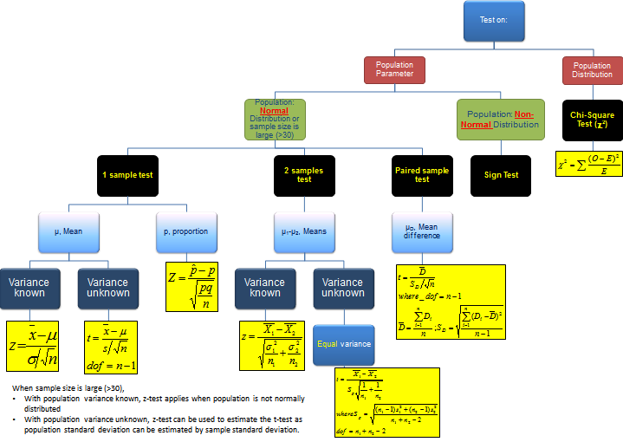
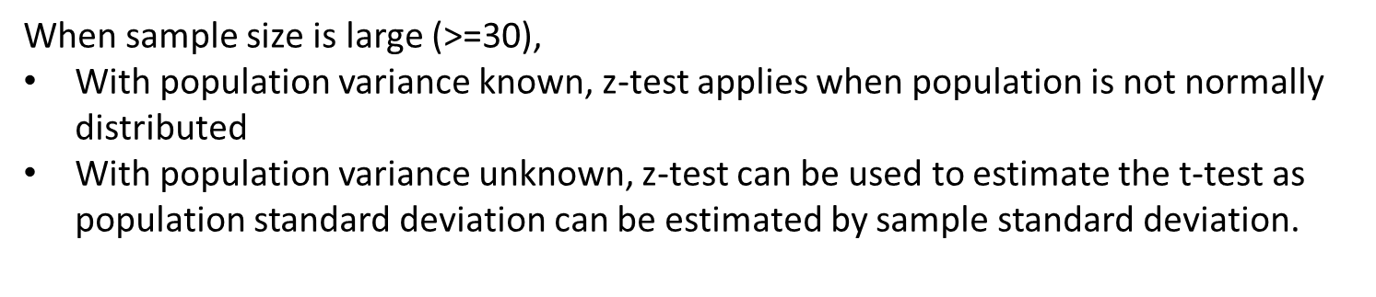
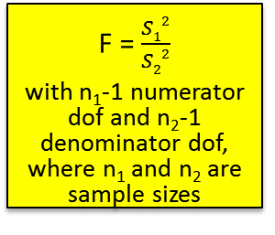
Topic Tree for Hypothesis Testing
ANOVA
A tool to compare the means of several (3 or more) populations with a single test.
L11
2 samples test on variance
σ₁² – σ₂²
F = $\frac{S12}{S22}$
with n₁-1 numerator dof and n₂-1 denominator dof, where n₁ and n₂ are sample sizes

Slide 4
What is ANOVA?
ANalysis Of VAriance (ANOVA) provides the tools to compare the means of several (3 or more) populations with a single test. The role of ANOVA is to perform a numerical test of significance that will test the equality of all the means.
The name, “Analysis of Variance”, may be misleading because the objective in ANOVA is to analyse differences among the group means, NOT the variances. However, by analyzing the variances (variation between and within the groups), we can conclude about possible differences in group means.
The basic ideas behind the statistical analysis (ANOVA and L08, 09, 10) are the same. The objective is to determine whether there is any evidence that the population means (or, “proportions”) are unequal, and if there is evidence, to ascertain which population means can be shown to be different and by how much.

Slide 5
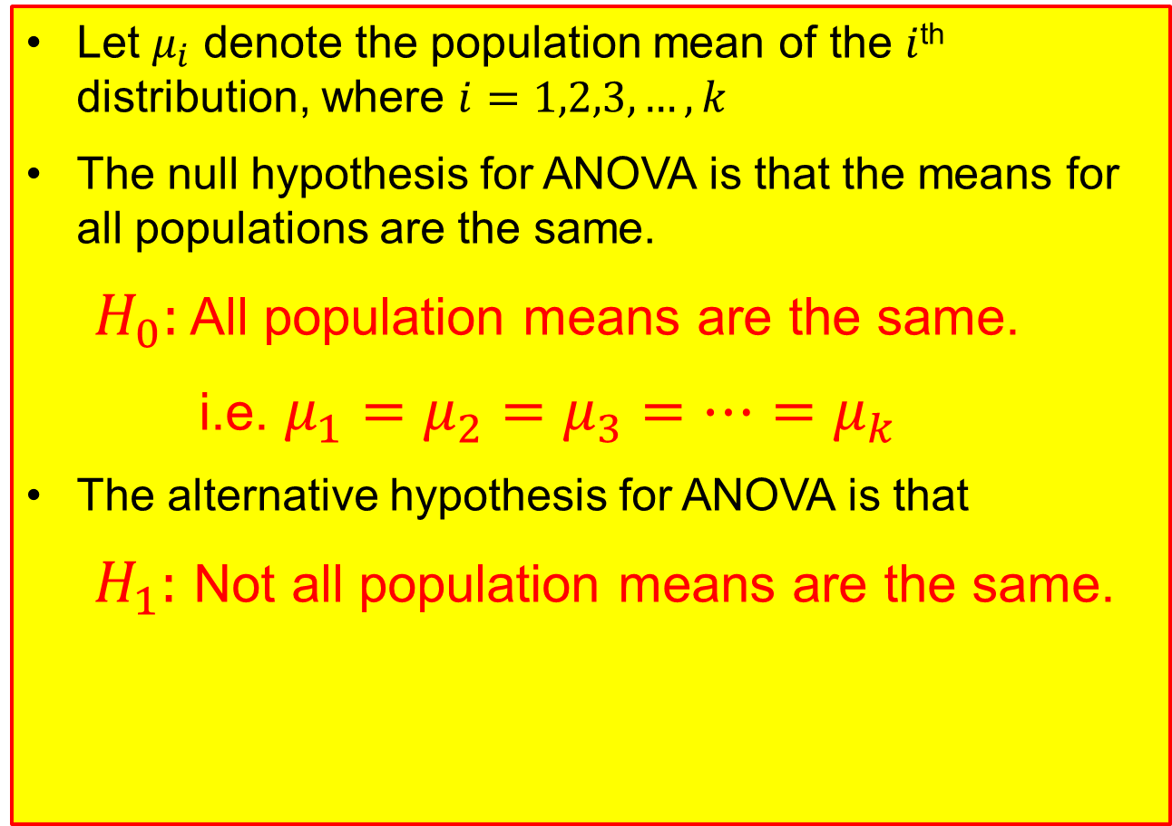
Formulation of Hypotheses in ANOVA
Let $μ_{i}$ denote the population mean of the $i$^{th} distribution, where $i=1,2,3,…,k$
The null hypothesis for ANOVA is that the means for all populations are the same.
$H_{0}:$ All population means are the same.
i.e. $μ_{1}=μ_{2}=μ_{3}=…=μ_{k}$
The alternative hypothesis for ANOVA is that
$H_{1}:$ Not all population means are the same.

Slide 6
Assumptions for ANOVA
ANOVA requires the following assumptions:
The populations are independent.
The populations follow normal distributions.
The populations have equal variances.
The difference of each observation from the overall mean can be divided into two parts:
The difference between the observation and the group mean (within each group)
The difference between the group mean and the overall mean (between groups)
ANOVA makes use of this partitioned variability. It is NOT required to have equal sample sizes in all treatment groups.
The F distribution is used in ANOVA for testing whether two or more sample means are from the same or equal populations.

Slide 7

The ANOVA F Test Statistic
The ANOVA F-test is a comparison of the average variability between groups to the average variability within groups.
The variability between groups is a measure of the spread of the group means around the overall mean for all groups combined. (E.g. differences of ratings between the 3 CAD models.)
The variability within each group is a measure of the spread of the data within each of the groups. (E.g. differences of ratings within each CAD model itself.)
If variability between groups is large relative to the variability within groups, the F statistic will be large;
If variability between groups is similar or smaller than the variability within groups, the F statistic will be small;
If the F statistic is large enough (greater than some threshold value, called the critical value), the null hypothesis that all means are equal is rejected.
$$F=\frac{Variability between groups}{Variability within groups}$$
ANOVA is always a right-tailed test

Slide 8
Characteristics of the F Distribution (Recap from L10)
Each member of the family is determined by two parameters: the numerator degrees of freedom (dof) and the denominator degrees of freedom (dof).
The F statistic cannot be negative and the F distribution is continuous.
Its value ranges from 0 to ∞ . As F → ∞, the curve approaches the x-axis.
The F distribution is positively (right) skewed.
Excel functions:
F.DIST(x, d₁, d₂,1) (returns left-tail probability of x)
F.DIST.RT(x, d₁, d₂) (returns right-tail probability of x)
F.INV(probability, d₁, d₂) (returns left-tail F value corresponding to ‘probability’).
F.INV.RT(probability, d₁, d₂) (returns right-tail F value corresponding to ‘probability’)
d₁: numerator degrees of freedom; d₂: denominator degrees of freedom

Slide 9
Illustration of Small F statistic
Within
Group
Group 1
mean
Group 2
mean
Overall mean
Group 3
mean
Source: Introduction to the Practice of Statistics, Moore and McCabe

Slide 10
Illustration of Large F statistic
Group 1
mean
Within group
Group 2
mean
Overall
mean
Group 3
mean
Source: Introduction to the Practice of Statistics, Moore and McCabe

Slide 11
Overview of Hypothesis Testing Procedure (Recap)
From problem, identify the population parameter of interest.
State clearly the null hypothesis H₀ and alternative hypothesis H₁.
State clearly the level of significance of the test (if not given in problem, we can assume typical value of 1%, 2% or 5%).
State the test statistic to be used, together with any necessary assumptions made.
Compute the value of the test statistic using the given sample data.
6. i) If using the critical region method: based on the stated level of significance , determine the critical value(s) and state the critical region.
ii) If using p-value method: based on the calculated value of test statistic, calculate the p-value.
7. Make a decision whether to reject H₀:
i) If using critical region method: Reject H₀ if calculated test statistic falls inside the critical region. Otherwise, do not reject H_{0.}
ii) If using p-value approach: Reject H₀ if p-value < level of significance. Otherwise, do not reject H_{0.}
8. Write down a formal conclusion in the problem context.

Slide 12
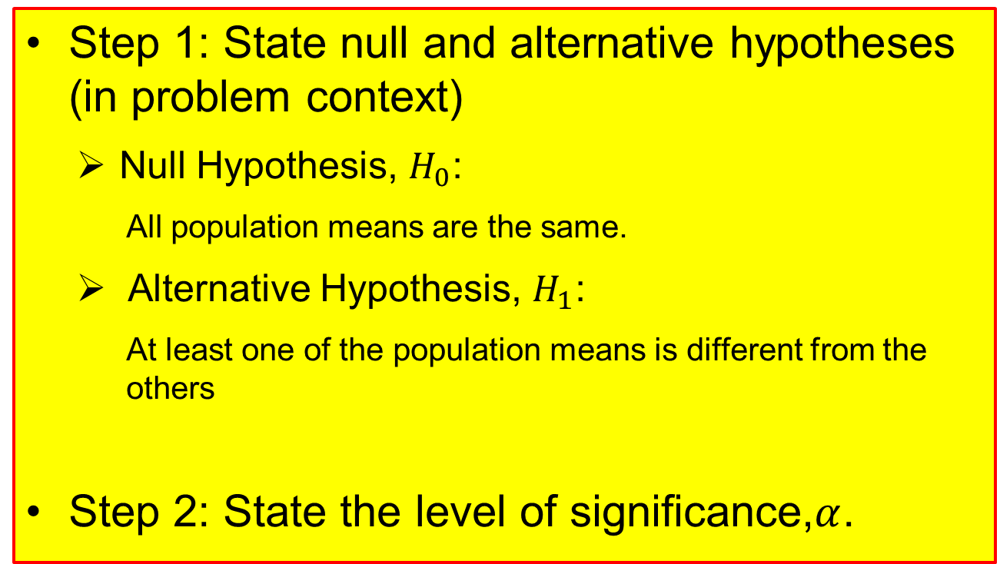
Procedures for conducting ANOVA (1)
Step 1: State null and alternative hypotheses (in problem context)
Null Hypothesis, $H_{0}$:
All population means are the same.
Alternative Hypothesis, $H_{1}$:
At least one of the population means is different from the others
Step 2: State the level of significance,$α$.

Slide 13



Procedures for conducting ANOVA (2)
Step 3: State the ANOVA F test statistic, with the associated degrees of freedom.
Step 4: Calculate the ANOVA F test statistic, $f_{cal}$
$F=\frac{MS(Tr)}{MSE}=\frac{\frac{SS(Tr)}{k−1}}{\frac{SSE}{n−k}}$ with
Numerator degrees of freedom (dof)
= $k−1$
Denominator degrees of freedom (dof)
= $n−k$
Note:
$k$ = number of independent populations
$n$ = total number of data observation values in the sample
SS(Tr) = Sum of Squares for Treatments
SSE = Sum of Squares for Errors
MS(Tr) = Mean Square for Treatments
MSE = Mean Square Error
There are two methods that we can use:
Method 1: Manual Calculation
Method 2: Excel

Slide 14
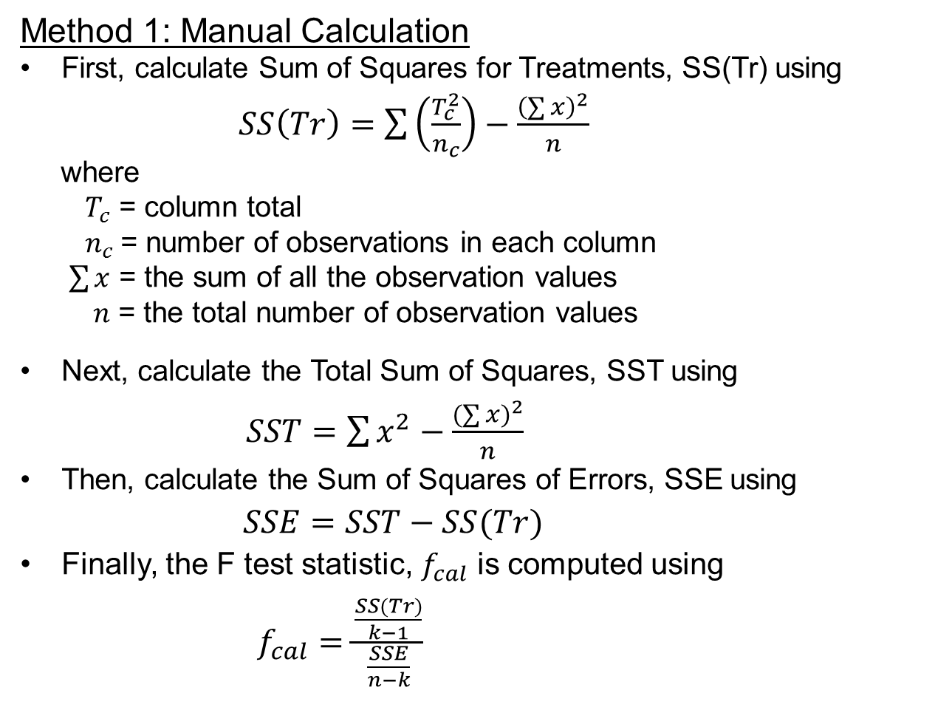
Procedures for conducting ANOVA (3)
Method 1: Manual Calculation
First, calculate Sum of Squares for Treatments, SS(Tr) using
$SS\left(Tr\right)=\sum{\left(\frac{T_{c}^{2}}{n_{c}}\right)−\frac{{\left(\sum{x}\right)}^{2}}{n}}$
where
$T_{c}$ = column total
$n_{c}$= number of observations in each column
$\sum{x}$ = the sum of all the observation values
$n$ = the total number of observation values
Next, calculate the Total Sum of Squares, SST using
$SST=\sum{x^{2}−\frac{{(\sum{x})}^{2}}{n}}$
Then, calculate the Sum of Squares of Errors, SSE using
$SSE=SST−SS(Tr)$
Finally, the F test statistic, $f_{cal}$ is computed using
$f_{cal}=\frac{\frac{SS(Tr)}{k−1}}{\frac{SSE}{n−k}}$

Slide 15
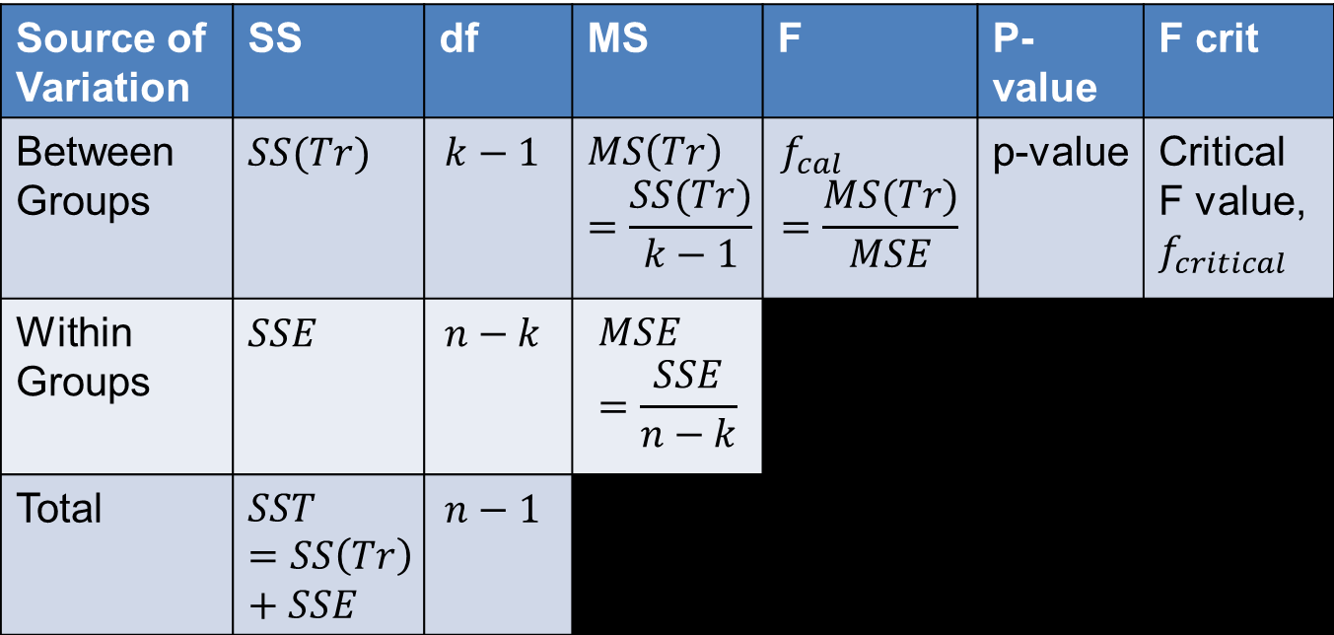
Procedures for conducting ANOVA (4)
Method 2: Excel
We will run through the steps for this method in the next example, but for now, please take note of the significance of each term and its relationship with the other terms in the output ANOVA table generated in Excel, as shown below:
Source of Variation | SS | df | MS | F | P-value | F crit
Between Groups | $$SS(Tr)$$ | $$k−1$$ | $$MS\left(Tr\right)=\frac{SS(Tr)}{k−1}$$ | $$f_{cal}=\frac{MS(Tr)}{MSE}$$ | p-value | Critical F value, $f_{critical}$
Within Groups | $$SSE$$ | $$n−k$$ | $$MSE=\frac{SSE}{n−k}$$
Total | $$SST=SS\left(Tr\right)+SSE$$ | $$n−1$$

Slide 16
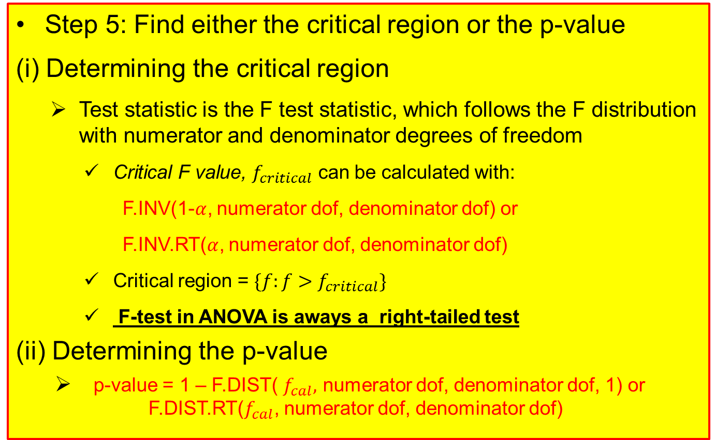
Procedures for ANOVA (5)
Step 5: Find either the critical region or the p-value
(i) Determining the critical region
Test statistic is the F test statistic, which follows the F distribution with numerator and denominator degrees of freedom
Critical F value, $f_{critical}$ can be calculated with:
F.INV(1-$α$, numerator dof, denominator dof) or
F.INV.RT($α$, numerator dof, denominator dof)
Critical region = $\{f:f>f_{critical}\}$
F-test in ANOVA is aways a right-tailed test
(ii) Determining the p-value
p-value = 1 – F.DIST( $f_{cal},$ numerator dof, denominator dof, 1) or F.DIST.RT($f_{cal}$, numerator dof, denominator dof)

Slide 17
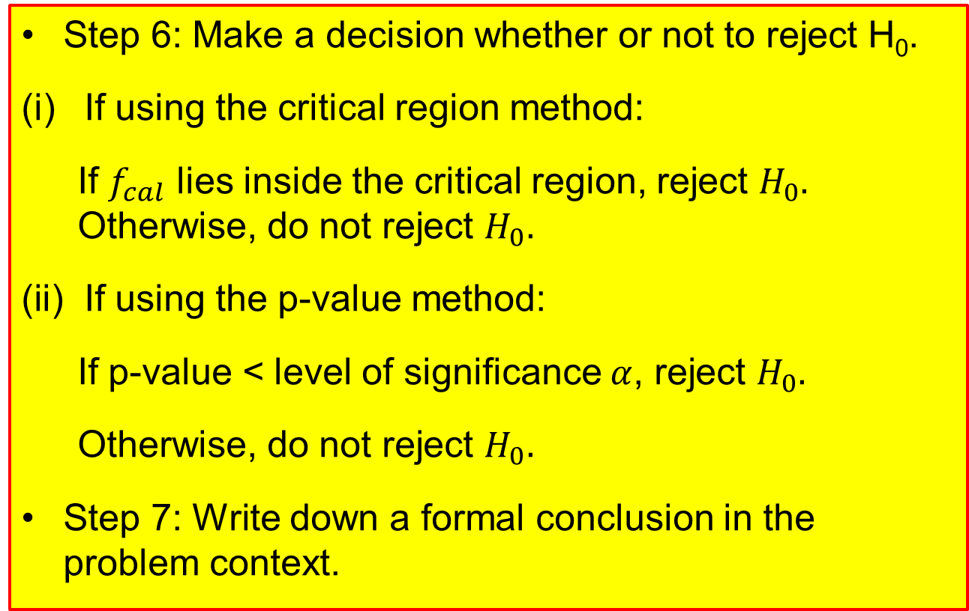
Procedures for ANOVA (6)
Step 6: Make a decision whether or not to reject H₀.
If using the critical region method:
If $f_{cal}$ lies inside the critical region, reject $H_{0}.$ Otherwise, do not reject $H_{0}.$
If using the p-value method:
If p-value < level of significance $α$, reject $H_{0}.$
Otherwise, do not reject $H_{0}.$
Step 7: Write down a formal conclusion in the problem context.

Slide 18
ANOVA: Example 1
It was known that a toxic material was dumped into a river leading into a large commercial fishing area. Engineers studied the way the water carried the toxic material by measuring the amount of material (in parts per million) found in oysters harvested at three different locations. The resulting data are provided in the table below:
Site 1 | Site 2 | Site 3
15 | 19 | 22
27 | 18 | 26
20 | 10 | 24
20 | 26 | 26
29 | 11 | 14
28 | 20 | 17
21 | 13 | 20
26 | 15 | Nil
Nil | 18 | Nil
Test whether there is a significant difference in the mean amount of toxic material found in oysters harvested at the three sites. Use 5% level of significance.

Slide 19
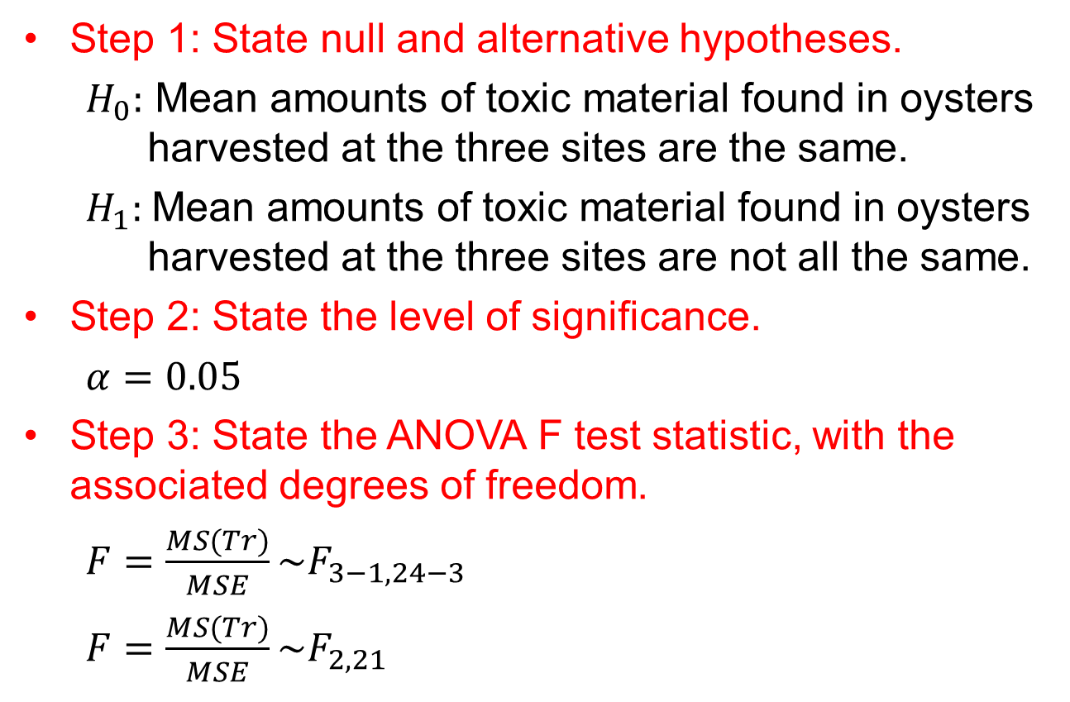
Example 1:Solution
Step 1: State null and alternative hypotheses.
$H_{0}:$ Mean amounts of toxic material found in oysters harvested at the three sites are the same.
$H_{1}:$Mean amounts of toxic material found in oysters harvested at the three sites are not all the same.
Step 2: State the level of significance.
$α=0.05$
Step 3: State the ANOVA F test statistic, with the associated degrees of freedom.
$F=\frac{MS(Tr)}{MSE}\sim F_{3−1, 24−3}$
$F=\frac{MS(Tr)}{MSE}\sim F_{2,21}$

Slide 20
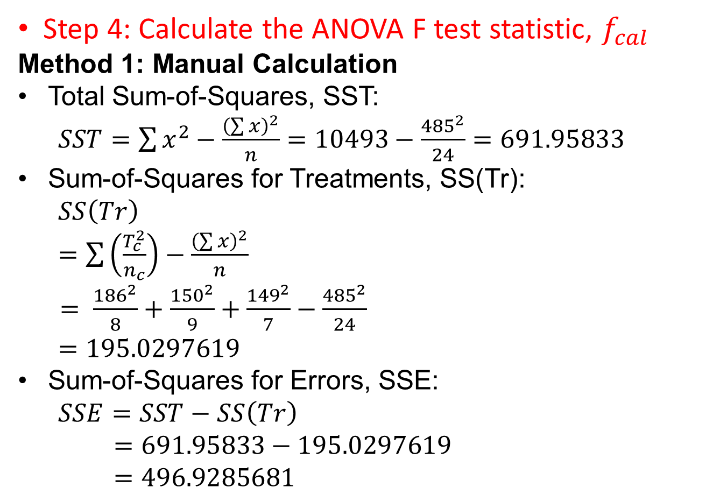
Example 1 Solution
Step 4: Calculate the ANOVA F test statistic, $f_{cal}$
Method 1: Manual Calculation
Total Sum-of-Squares, SST:
$SST=\sum{x^{2}−\frac{{\left(\sum{x}\right)}^{2}}{n}=10493−\frac{{485}^{2}}{24}}=691.95833$
Sum-of-Squares for Treatments, SS(Tr):
$SS\left(Tr\right)$
$=\sum{\left(\frac{T_{c}^{2}}{n_{c}}\right)−}$ $\frac{{\left(\sum{x}\right)}^{2}}{n}$
$= \frac{{186}^{2}}{8}+\frac{{150}^{2}}{9}+\frac{{149}^{2}}{7}−\frac{{485}^{2}}{24}$
$=195.0297619$
Sum-of-Squares for Errors, SSE:
$SSE=SST−SS\left(Tr\right)$
$=691.95833−195.0297619$
$=496.9285681$

Slide 21
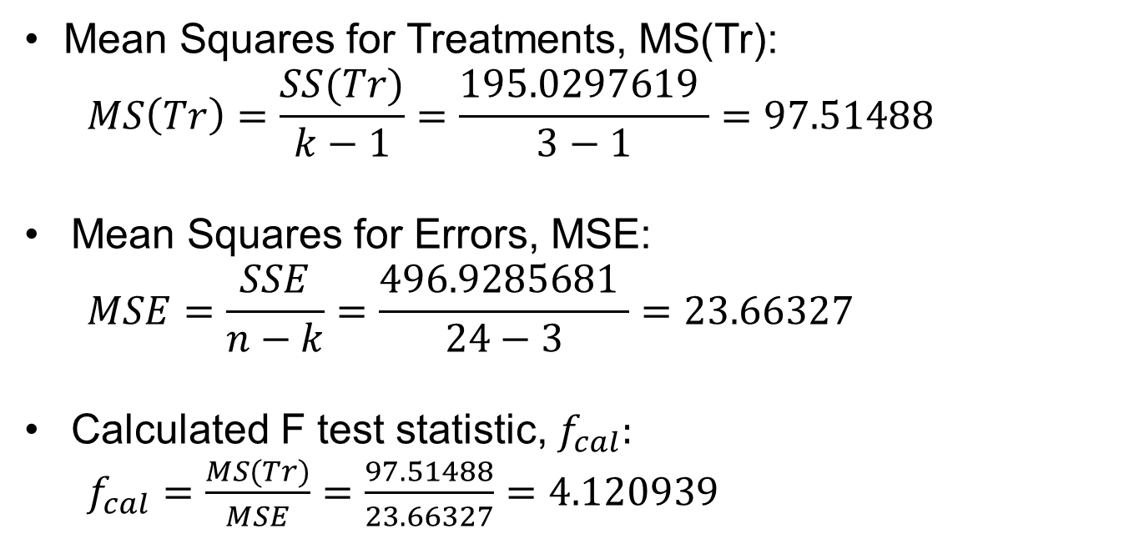
Example 1 Solution
Mean Squares for Treatments, MS(Tr):
$$MS\left(Tr\right)=\frac{SS(Tr)}{k−1}=\frac{195.0297619 }{3−1}=97.51488$$
Mean Squares for Errors, MSE:
$$MSE=\frac{SSE}{n−k}=\frac{496.9285681 }{24−3}=23.66327$$
Calculated F test statistic, $f_{cal}:$
$f_{cal}=\frac{MS(Tr)}{MSE}=\frac{97.51488}{23.66327}=4.120939$

Slide 22
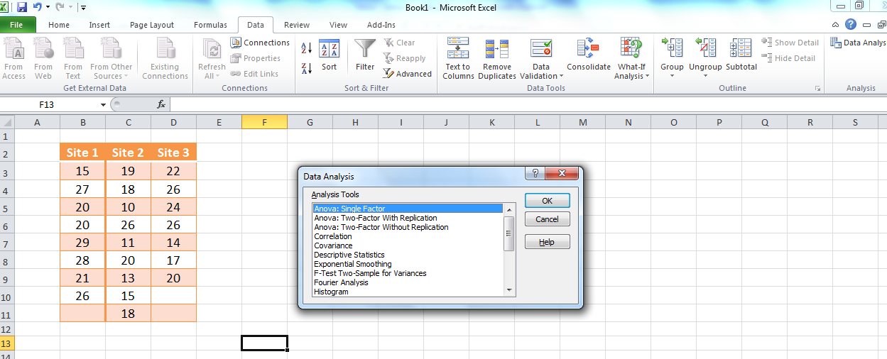
Example 1 Solution
Method 2: Excel
In Excel, click on “Data” tab and then select “Data Analysis”. Select “ANOVA: single factor”

Slide 23
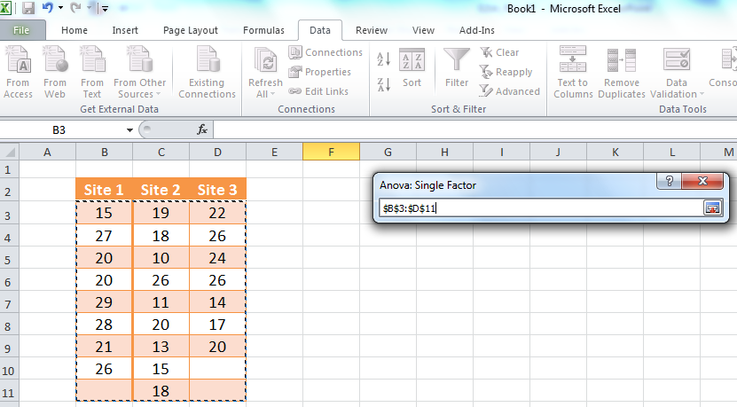
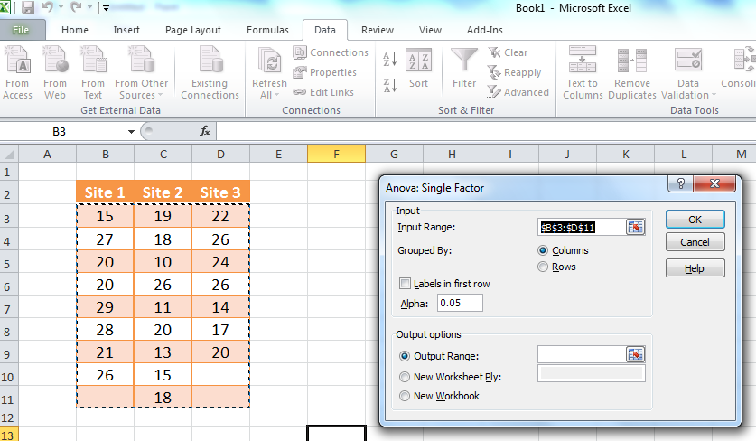
Example 1 Solution
Under “Input Range”, click and drag across the cells containing the data values.
Remember to select
“Grouped By Columns”
and enter the value of
level of significance.

Slide 24
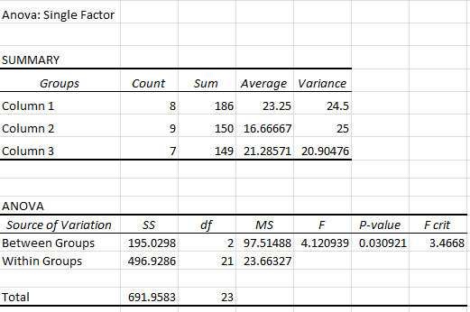
Example 1 Solution
ANOVA Output Table:
fcal
=MS(Tr)/MSE
MS(Tr)
=SS(Tr)/(k-1)
SS(Tr)=SST-SSE
k-1
P-value
Critical F value
SSE=SST-SS(Tr)
n –k
MSE= SSE/(n-k)
SST=SS(Tr)+SSE
n-1

Slide 25
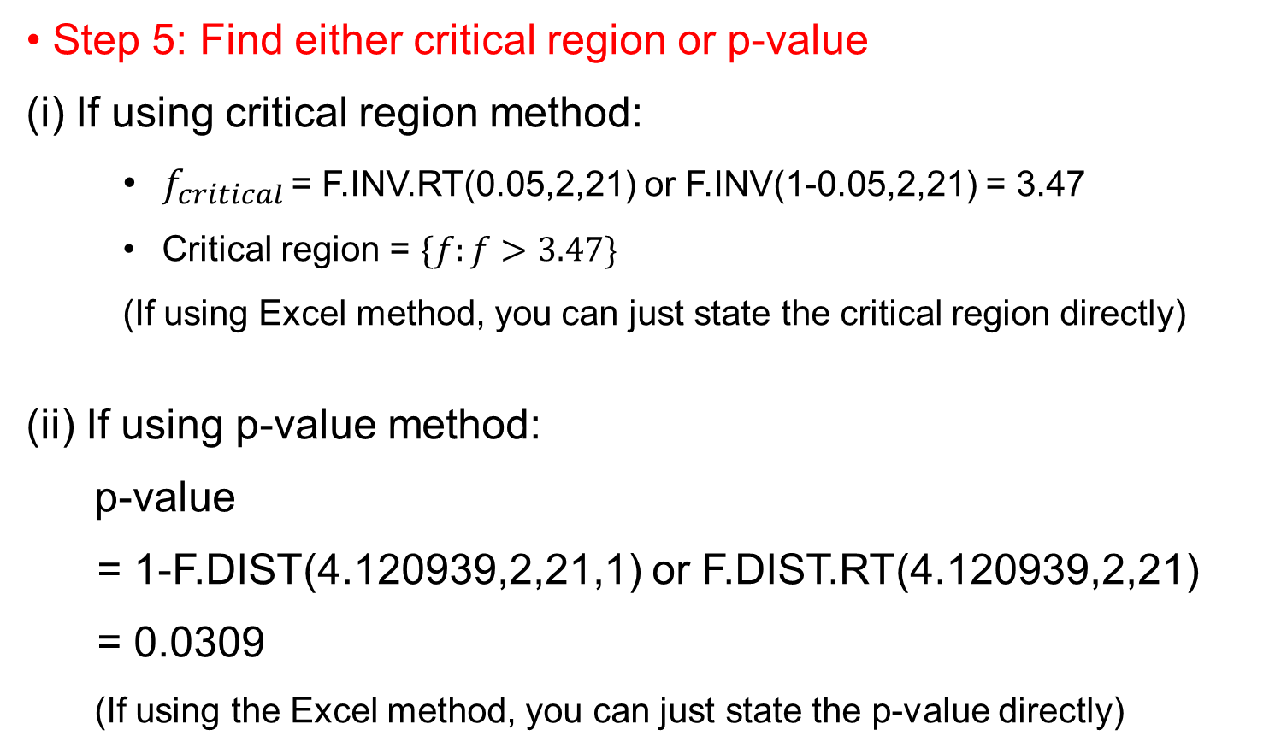
Example 1 Solution
Step 5: Find either critical region or p-value
(i) If using critical region method:
$f_{critical }$= F.INV.RT(0.05,2,21) or F.INV(1-0.05,2,21) = 3.47
Critical region = $\{f:f>3.47\}$
(If using Excel method, you can just state the critical region directly)
(ii) If using p-value method:
p-value
= 1-F.DIST(4.120939,2,21,1) or F.DIST.RT(4.120939,2,21)
= 0.0309
(If using the Excel method, you can just state the p-value directly)

Slide 26
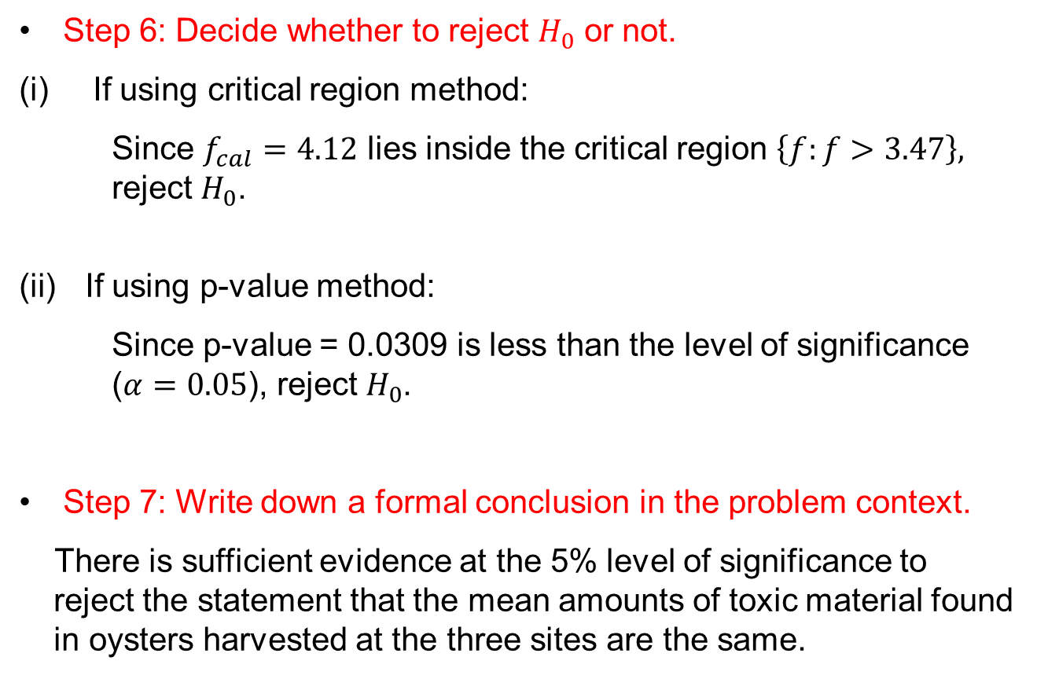
Example 1 Solution
Step 6: Decide whether to reject $H_{0}$ or not.
If using critical region method:
Since $f_{cal}=4.12$ lies inside the critical region $\left\{f:f>3.47\right\},$ reject $H_{0}$.
If using p-value method:
Since p-value = 0.0309 is less than the level of significance ($α=0.05$), reject $H_{0}$.
Step 7: Write down a formal conclusion in the problem context.
There is sufficient evidence at the 5% level of significance to reject the statement that the mean amounts of toxic material found in oysters harvested at the three sites are the same.

Slide 27
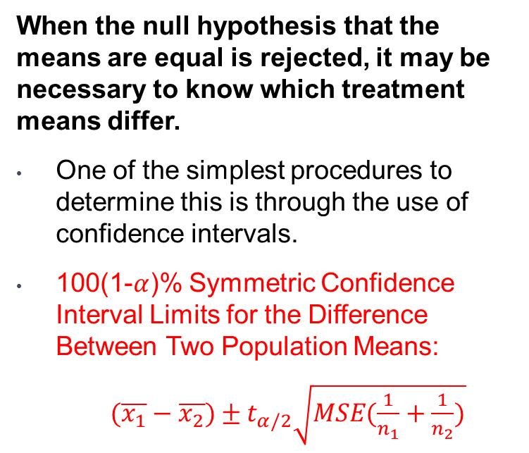
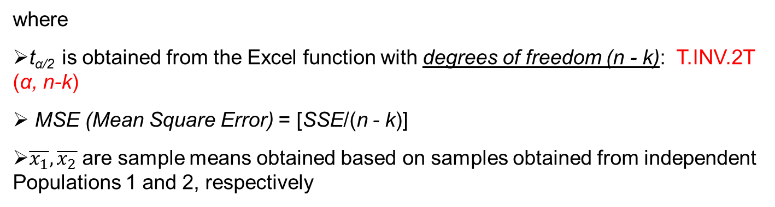
Inferences About Treatment Means
When the null hypothesis that the means are equal is rejected, it may be necessary to know which treatment means differ.
One of the simplest procedures to determine this is through the use of confidence intervals.
100(1-$α$)% Symmetric Confidence Interval Limits for the Difference Between Two Population Means:
$(\overline{x_{1}}−\overline{x_{2}})±t_{α/2}\sqrt{MSE(\frac{1}{n_{1}}+\frac{1}{n_{2}})}$
Note:
This is just one of the many post-hoc tests available, after ANOVA test, called Fisher’s Least Significant Difference (LSD) test.
One drawback of this test is that the type I error rate will increase, but if the number of independent populations is small, the impact will be small.
Other types of post-hoc tests are Tukey’s procedure, Bonferroni procedure, Scheffe’s method, which are beyond the scope of E214. The interested student can refer to https://en.wikipedia.org/wiki/Post_hoc_analysis for more information on these alternative tests.
where
t_{α/2} is obtained from the Excel function with degrees of freedom (n - k): T.INV.2T (α, n-k)
MSE (Mean Square Error) = [SSE/(n - k)]
$\overline{x_{1}}, \overline{x_{2}}$ are sample means obtained based on samples obtained from independent Populations 1 and 2, respectively

Slide 28
Example 2: Confidence Interval
For Example 1, develop a 95% confidence interval for the difference in the mean amount of toxic material found in oysters harvested at Sites 1 and 2.
Can the engineers conclude that there is a difference between the two mean amounts of toxic material found in oysters harvested at these two sites?

Slide 29
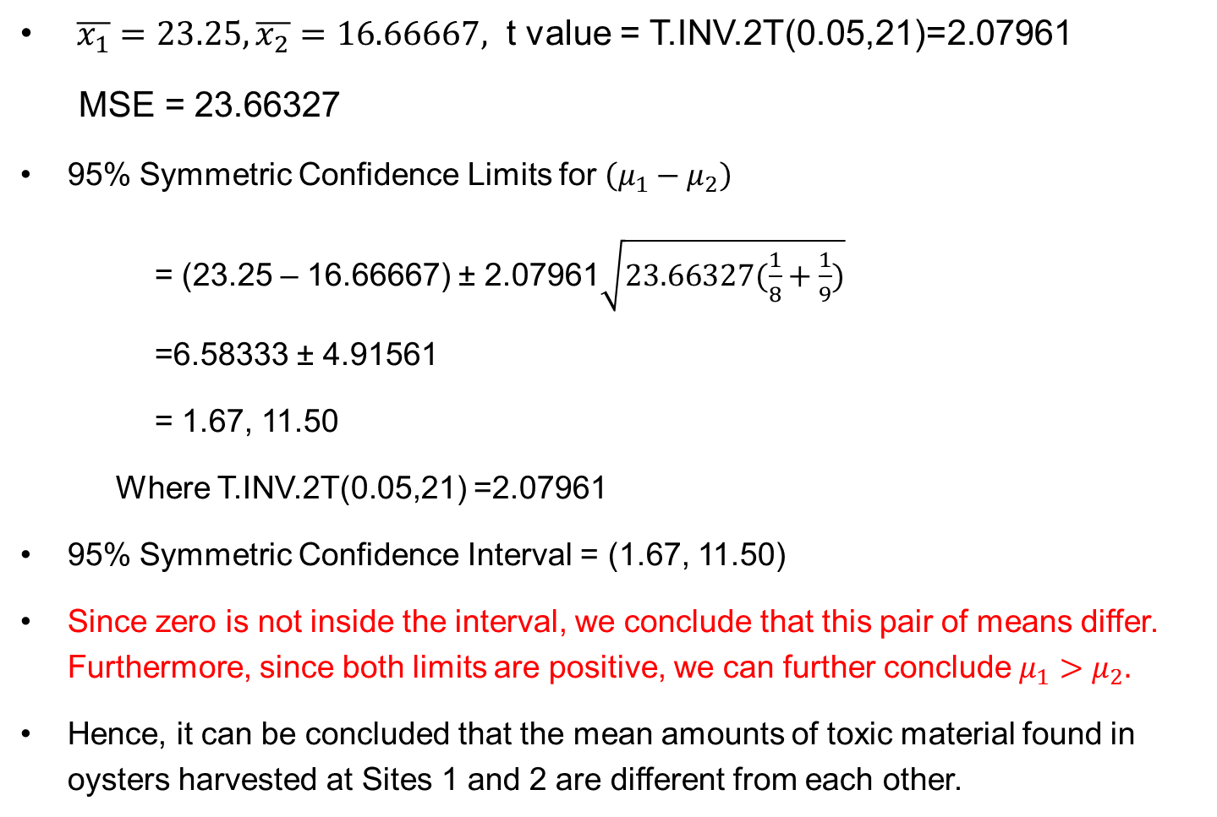
Example 2: Proposed Solution
$\overline{x_{1}}=23.25, \overline{x_{2}}=16.66667,$ t value = T.INV.2T(0.05,21)=2.07961
MSE = 23.66327
95% Symmetric Confidence Limits for $\left(μ_{1}−μ_{2}\right)$
= (23.25 – 16.66667) ± 2.07961$\sqrt{23.66327(\frac{1}{8}+\frac{1}{9})}$
=6.58333 ± 4.91561
= 1.67, 11.50
Where T.INV.2T(0.05,21) =2.07961
95% Symmetric Confidence Interval = (1.67, 11.50)
Since zero is not inside the interval, we conclude that this pair of means differ. Furthermore, since both limits are positive, we can further conclude $μ_{1}>μ_{2}.$
Hence, it can be concluded that the mean amounts of toxic material found in oysters harvested at Sites 1 and 2 are different from each other.

Slide 30
Learning Objectives
Apply Analysis of Variance (ANOVA) to test for equality of population means among multiple independent populations
Calculate the confidence interval for the difference in population means for any two independent populations

Slide 31
E-Learning Video
You are strongly encouraged to watch the e-learning video prepared for P11 to enhance your understanding of the main learning objectives.
You can access the e-learning video from the following link:
https://drive.google.com/file/d/0B0VVo-P5cYtqQ2t4X2hGX0VfY00/edit?usp=sharing

